Slide 1
Historical Artifact Boxes

Slide 2
Extra Credit
The Choice 2016 (PBS Frontline): Due by November 7th
The 13th: Netflix Documentary Due by December 12th
Catching Hell: Due by October 31st – May be available on Netflix – is on ESPN website

Slide 4
History
History is not a set of facts, but a long series of arguments that continue to this day.
How we interpret those arguments, and where we ultimately stand on them, determines our point of view, the way we think and vote, how we treat others, our expectations of our country and leadership, and so on.
The choices we make, and the choices our ancestors have made, have incredible implication on the lives of others today and years from now.
Nothing exists or matters outside of history and where it is pushing us into the future. Science, business, art and culture, everything is being effected by history and current events.

Slide 5
Artifact Boxes
How to study history?
Look at, listen to, watch, the contents of each “box”.
You will eventually be responsible for nearly all this information, but for now just look it over without pressure.
Complete the organizer. Be as thoughtful about your responses as possible. Quick answers will not help you later.
Keep it when you are finished.
Do this individually, “group think” can be dangerous and it is worth the time to engage material on your own.

Slide 6
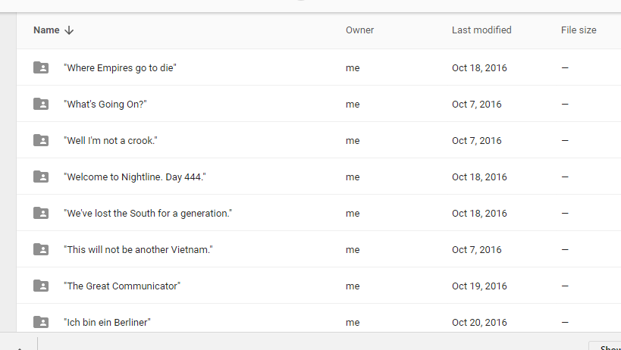

Slide 7
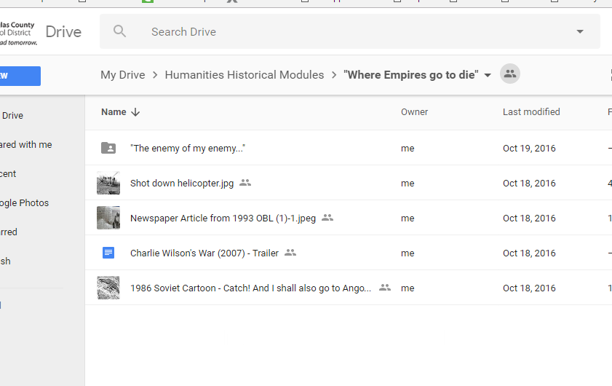

Slide 8
Artifact Boxes
Pick at least three “boxes” you are most interested to learn more about.
In each “box,” you will find images, maps, political cartoons, and multiple types of videos.
Use the proper tools to analyze the contents of the boxes you picked to try and build a greater understanding of them.
Example: Use political cartoon analysis guide to understand political cartoons, song analysis guide to understand songs, etc…
Videos: Write the content of the videos and then discuss the purpose of the video (some are easier than others)
Right answers are not yet necessary, but well thought out ones are required.

Slide 9
Developing Questions:
Pick at least one of the artifact boxes/folders you find the most interest in researching further
Develop at least 10 questions you can ask about this topic
Should be questions that are thought through, non-googleable, and provoke further interest of study you can pursue later
Keep the current event topics we worked on during 1st term in mind when developing these questions.
How do these events connect to the election, War on Terror, Privacy, modern Civil Rights issues?

Slide 11
Open vs. Closed Questions
Closed questions: Typically result in yes or no answers.
Open questions: Require more than one word answers. Are meant to spark longer conversations.

Slide 12
Closed Examples Open Examples
Are you feeling better today?
May I use the bathroom?
Is the prime rib a special tonight?
Should I date him?
Will you please do me a favor?
Have you already completed your homework?
Is that your final answer?
Were you planning on becoming a fireman?
What are you planning to buy today at the supermarket?
How exactly did the fight between the two of you start?
What is your favorite memory from childhood?
How will you help the company if you are hired to work for us?
What do you plan to do immediately following graduation from college?
What was your high school experience like?

Slide 13
Open vs. Closed Questions
Look over your questions
On a separate sheet of paper, categorize them into open and closed questions
Turn an open question into a closed question and a closed question into an open question.
Now turn all of your closed questions into open questions.
On the back or a new sheet of paper, rank your questions from most thought provoking to least

Slide 14
Rest of Today
Finish Ranking Questions and turn in by end of class
Continue work on annotated bibliography (no late work will be accepted*)
Work on extra credit options
Honors students work on assignment

Slide 15
Group Questions (part 1)
In your assigned groups, develop a top twenty (or more, but not less) list of questions.
These should be questions that provoke arguments, not questions that ask for a discussion of facts.
Examples of what not to do:
What happened on 9/11?
Was Ronald Regan a great president?
Why did Nixon lie?
Why did Bill Clinton cheat on his wife?
Think about questions that have as much meaning in the past as they do now.

Slide 16
Group Questions (part 2)
You have a group list of at least 20 questions
Now on a sheet of paper to turn in, find a top 5 list of questions to submit as the best, most interesting, provoking, and relevant questions possible
Any questions you liked but didn’t make the cut, put in a secondary list on the bottom, and make a third “discarded list” of any questions you added just to make the 20
Three of these questions will be assigned as small Socratic Discussion with your group (assignment details will come after final questions are chosen)

Slide 17
Annotated Bibliography
Due November 4th, beginning of class
5 source annotated bibliography.
1 documentary
3 articles (bonus points for scholarly journals)
1 book
Add more if needed, this is not a final list of sources for your menu project.

Slide 18
Upcoming Assignments
Annotated Bibliography Due beginning of class, November 4th
Socratic Seminar Due: November 9-10th
Work Days: time to discuss paper rewrites, projects, and current assignments
Work is easy to complete if you do the right thing; class becomes difficult if you waste time

Slide 20
Socratic Seminar
I will collect seminars with papers on Friday, November 18th
Post Socratic Seminar:
Send me an email with
Most interesting thing you’ve learned AND would like to continue to learn about your topic
Three (3) questions you have about your topic that you would could possibly answer
I will choose one of those or adjust them to form a question for your essay that will be assigned on Monday

Slide 21
Paper due start of class November 18th
Three to four page argumentative essay answering your assigned question. Essay must follow all rules as previous papers (MLA format, evidence based argument, works cited page, no 1st person, 2nd person, contractions, hard copy). View the documents on website for your essay question. If you do not have an essay question, you did not send Mr. Pelster an email with most interesting facts and questions for further research.

Slide 22
Essay Questions
We worked hard to get questions as close to what you are interested in as possible
Answer that question with your own thesis, and prove the argument
We have our own ideas or opinions before we read your paper so you have to prove your argument to the best of your ability or it will reflect in grade
That means you need to have high quality sources, argumentative tone, embedded and explained evidence, argumentative and clear thesis, refuted and addressed counter argument, minimal grammar errors, proper word choice

Slide 23
But how?
Social studies skills are shown in how you:
research
analyze of wide variety of sources from a large array of places
synthesize ideas
Analyze many different arguments and deciding which is most accurate
use sources to prove your argument
Understand cause and effect of history and modern events on each other

Slide 24
Cool. But seriously, how?
Look in artifact boxes for sources
Find wide variety of sources including internet articles, primary sources, documentaries, books, magazines, youtube videos, outside experts, classmates with similar assignments
Talk to us about your findings and questions
Get away from distractions and take the designated time to learn without a teacher structuring your time for you.
This is how learning actually happens. These are the skills you need to develop: research, critical thinking, initiative, time management

