Slide 1
The Great Gatsby Introduction
Humanities II

Slide 2
Modernism
Literary time period from 1915-1950ish
Desire to break away from established traditions
A quest to find fresh ways to view man’s position or function in the universe
Experiments in form and style
Emphasis on subjectivity (ex. the reader interprets themes instead of the writer explicitly stating them)

Slide 3
F. Scott fitzgerald
The “F” stands for Francis.
1896-1940
Member of the “Lost Generation”
His first written work was published in his school paper at the age of 13.

Slide 4
Reviews
“Fantastic proof that chivalry, of a sort, is not dead” – New York Times (May 7, 1925)
“F. Scott Fitzgerald deserves a good shaking…The Great Gatsby is an absurd story, whether considered as romance, melodrama, or plain record of New York high life.” – Saturday Review of Literature (1925)

Slide 5
Themes
The American Dream (Rags to Riches)
The idea held by many in the U.S. that through hard work, courage, and determination one can achieve financial and personal success.
Which characters embody the American dream? What do you think Fitzgerald is trying to say about the American dream through the experiences of the characters?
Social Classes
New money, old money, and no money
Notice the social class of each character. What is Fitzgerald saying about the class system in America through the experiences of the characters?

Slide 6
Symbols
The Green Light
Why is the light so important to Gatsby? What does it represent to him?
The Valley of the Ashes
Located between East Egg and West Egg, this is a dirty and desolate place. What does this land represent?
The Eyes of Dr. Eckleberg
What do the eyes on the faded billboard in the Valley of the Ashes represent? Why does the narrator keep mentioning them? When does he mention them?
Color Symbolism
White, yellow/gold, silver, red, etc. Refer to your notes on color theory.

Slide 7
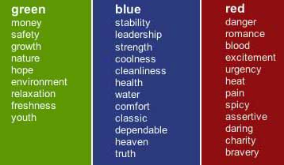
Color Symbolism

Slide 8
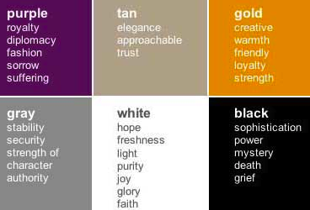
Color Symbolism

Slide 9
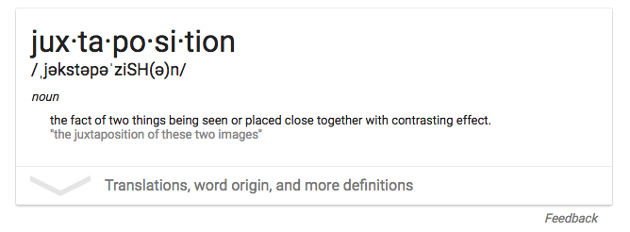
Juxtaposition

Slide 10
Resources
Information about F. Scott Fitzgerald and the time period
http://www.fitzgeraldsociety.org/
Full glossary
http://www.cliffsnotes.com/study_guide/literature/great-gatsby/study-help/full-glossary-for.html
Online version of the novel
http://ebooks.adelaide.edu.au/f/fitzgerald/f_scott/gatsby/chapter1.html#chapter1
Character descriptions
http://quizlet.com/10571437/the-great-gatsby-character-list-flash-cards/

